Slide 1
Advanced Programming(OOP) Lab Project Title: Student Attendance Management System
Problem Statement: Manual attendance is time-consuming and error-prone
Target User: Teachers / Academic Staff

Slide 2
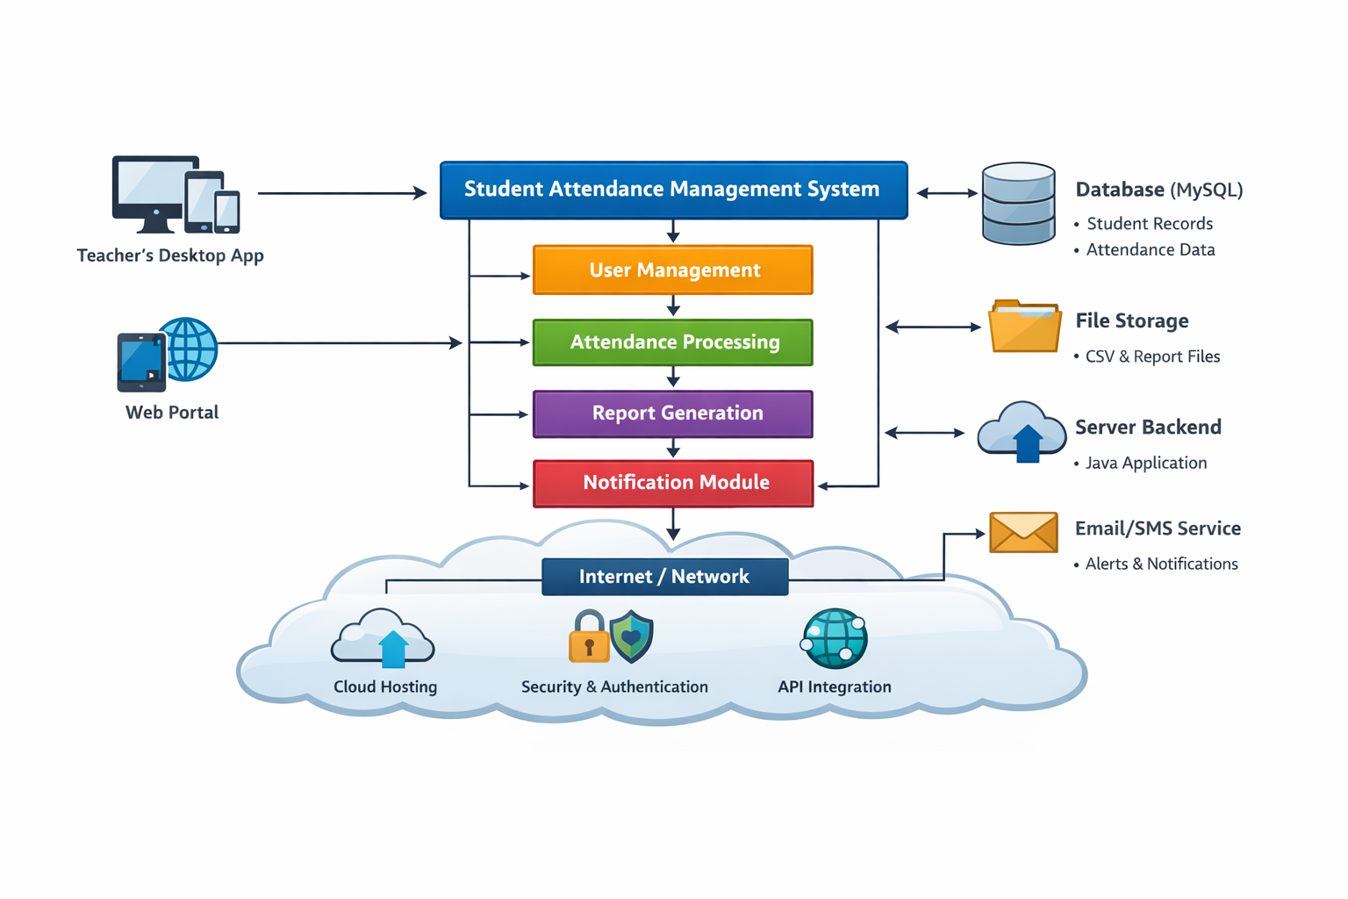
System Design
Architecture: Modular Object-Oriented Design
Key Classes: User, Student, AttendanceRecord, AttendanceManager
Responsibilities:
1.Manage students
2.Track attendance
3.Generate reports
Package Structure: Single package with multiple classes

Slide 3
OOP Concept Used
Abstraction: Separate classes for different functionalities
Inheritance: Student extends User
Polymorphism: Method overriding in AttendanceRecord
Design Pattern: Manager class controls system operations

Slide 4
Technical Highlights
HashMap used for storing date-wise attendance
ArrayList used for managing student records
File handling used to save data
Chosen for efficiency, flexibility, and scalability

Slide 5
Live Demo
Add student and display list
Mark attendance and generate report
Show attendance percentage calculation
Demonstrate invalid input handling

